Slide 1
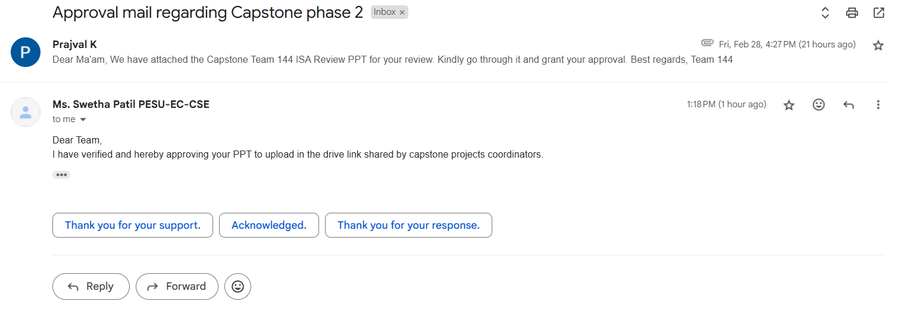

Slide 2
UE22CS320A – Project Phase – 2
Capstone Project –Phase 2 –review 1
PROJECT TITLE : AVIOS – Adaptive Vigilant Intelligent Operating System
PROJECT ID : Team 144
PROJECT GUIDE : Prof. Swetha Patil
PROJECT TEAM
Kurumeti Prajval ( PES2UG22CS274 )
Manoj Kumar KS ( PES2UG22CS302 )
Dhanushree K ( PES2UG22CS176 )
Nagaratna ( PES2UG22CS331 )

Slide 3
Agenda
Problem Statement
Abstract and Scope
Suggestions from Phase-1
Requirements Specification
Design Approach
Design Constraints, Assumptions & Dependencies
Proposed System / Approach
Architecture
Design Description
Project Progress
References

Slide 4
Problem Statement
Artificial Intelligence based Task Scheduling
Modern operating systems handle diverse workloads, from real-time tasks to background processes, but traditional schedulers like Linux CFS rely on static heuristics, leading to inefficient CPU allocation, higher latency, and increased power consumption. Existing solutions lack adaptability, failing to dynamically optimize resource allocation based on real-time system demands.
AVIOS – Adaptive Vigilant Intelligent Operating System aims to bridge this gap by integrating AI into scheduling. By analyzing process behavior, predicting optimal CPU time (vruntime), and modifying scheduling policies dynamically, AVIOS ensures: Faster execution for critical tasks , Optimized CPU utilization and
Energy-efficient workload management.
By embedding AI-driven task scheduling into the Linux kernel, AVIOS enhances system responsiveness and performance, making OS scheduling truly adaptive and intelligent.

Slide 5
Abstract and Scope
Abstract :
AVIOS – Adaptive Vigilant Intelligent Operating System introduces AI-powered task scheduling in the Linux kernel to dynamically allocate CPU resources based on real-time process behaviour. By leveraging machine learning models in user space to predict optimal time slices (vruntime) and modifying scheduling policies via system calls, AVIOS enhances system efficiency, reduces latency, and optimizes CPU utilization for diverse workloads.
Scope:
AVIOS is designed for high-performance computing, cloud environments, and real-time systems, ensuring adaptive scheduling for diverse workloads. It improves CPU efficiency, energy management, and responsiveness, making it suitable for datacenters, AI/ML workloads, and low-latency applications. Future extensions include integration with cloud-native orchestration systems like Kubernetes for distributed scheduling.

Slide 6
Suggestions from Phase-1
Moving Forward with AI Task Scheduling Feature
After careful consideration and feedback, we have decided to focus on AI-based Task Scheduling as the primary feature of our project. This decision is based on its potential to optimize task execution, improve efficiency, and enhance system performance.

Slide 7
Requirements Specification
Functional Requirements
1) AI-Based Task Scheduling :
The system must classify tasks into real-time (RT) and Resource Intensive Task (RIT) based on resource usage.
It must predict optimal time slices (STS) for each task using a machine learning model.
The AI model should dynamically adjust scheduling policies.
2) Kernel-Level Task Execution :
The modified scheduler must support SCHED_RR (real-time) and SCHED_OTHER (CFS).
It should ensure low-latency execution for high-priority tasks.
The scheduler should modify CPU time slice allocation based on AI predictions.
3) User-Kernel Communication :
The AI model should send predictions via system calls (sched_setscheduler()).
Alternative Netlink sockets may be used for real-time communication.
4) Process Monitoring & Data Collection :
The system must monitor CPU, memory, I/O usage, and context switch rates.
Data collection should use perf, psutil, and other Linux monitoring tools.
5) Integration & Deployment :
The AI model should be deployable using Docker & Kubernetes for scalability.
The system should support distributed scheduling with Redis, RabbitMQ, or Kafka.

Slide 8
Requirements Specification
Non-Functional Requirements
1) Performance & Efficiency :
The system should reduce CPU starvation and scheduling latency.
It must improve CPU utilization by dynamically adjusting task priorities.
2) Scalability & Flexibility :
Should handle large-scale task scheduling across multiple cores.
The system should support containerized deployment via Docker & Kubernetes.
3) Reliability & Fault Tolerance :
AI-based scheduling should handle unexpected workload variations.
The system must ensure graceful failure recovery in case of AI model failure.
4) Security & Access Control :
Only privileged processes should modify scheduling parameters.
Secure communication between AI and Kernel to prevent unauthorized access.
5) Observability & Debugging :
Performance metrics should be monitored via Prometheus & Grafana.
Logs should be stored for debugging and model evaluation.

Slide 9
Requirements Specification
Technologies for AI Task Scheduling
Python
C
Scikit-Learn (sklearn)
Linux Kernel
Docker
Redis/RabbitMQ
TensorFlow
PyTorch
Apache Kafka
Kubernetes
OpenMP
MPI
Celery
Prometheus
Grafana
Dask
Ray

Slide 10
Design Approach
What is the design approach followed? And Why?
The design approach for AVIOS follows an AI-powered dynamic scheduling system, where: 1) An AI model in user space predicts the optimal time slice (STS) for tasks. 2) The Linux kernel scheduler modifies CPU allocation based on these predictions via system calls. 3) The system dynamically adapts to process behavior, optimizing resource allocation in real-time.
Why this approach?
Adaptability: Unlike traditional schedulers, AI can learn and adjust to different workloads dynamically.
Performance Optimization: Reduces CPU starvation and ensures efficient utilization.
Energy Efficiency: Prioritizes critical tasks while delaying non-essential ones to save power.
Scalability: Can be extended to multi-core, cloud, and distributed environments.

Slide 11
Design Approach
Benefits:
Real-time Optimization: AI-driven scheduling minimizes latency for critical tasks.
Smart Resource Allocation: CPU time is distributed dynamically based on usage patterns.
Self-Learning Mechanism: AI continuously improves scheduling efficiency over time.
Drawbacks:
Computational Overhead: Running an AI model for scheduling introduces some CPU load.
Model Training Complexity: Requires high-quality data to ensure accurate predictions.
Kernel-Level Integration Risks: Modifying the Linux scheduler may lead to stability issues if not handled properly.

Slide 12
Design Constraints, Assumptions & Dependencies
Design Constraints :
Low-Latency Decision Making: The AI model must make scheduling decisions within milliseconds to avoid performance bottlenecks
Kernel Integration Complexity: The modified scheduler must be stable and should not introduce unintended system crashes.
Resource Utilization: The AI process itself must not consume excessive CPU resources, defeating the purpose of optimization.
Security Considerations: The communication between AI and the kernel should prevent unauthorized modifications to scheduling policies.
Assumptions :
The AI model has access to sufficient training data to predict STS accurately.
Kernel modifications will follow Linux’s open-source guidelines to maintain stability.
The system will run on modern multi-core processors to take advantage of AI scheduling benefits.
User-space monitoring tools (like perf and pstuil) provide real-time process behavior data without delays.

Slide 13
Design Constraints, Assumptions & Dependencies
Dependencies & Impact on the Project :
1) Dependency on System Calls (sched_setscheduler())
The AI model sends predictions via system calls to modify scheduling.
Impact: Requires kernel modifications and proper permission handling.
2) Dependency on Process Monitoring Tools
Uses perf, psutil, and system logs to track process execution.
Impact: Monitoring tools must run efficiently without affecting system performance.
3) Dependency on AI Model Accuracy
If the model predicts incorrect STS values, scheduling will become inefficient.
Impact: Requires continuous model training and validation.
4) Dependency on Multi-Core CPUs
The system is designed for modern multi-core processors.
Impact: Performance benefits may vary on single-core machines.

Slide 14
Proposed System / Approach
Basic Approach & Initial Results
Initial Approach (Traditional Linux Scheduling)
The Completely Fair Scheduler (CFS) in Linux assigns CPU time slices statically, based on heuristics like process priority and fairness.
No intelligent adaptation based on real-time workload behavior.
Limitations Identified:
High latency for critical tasks.
Inefficient resource allocation for background processes.
Inflexibility—cannot dynamically adjust to changing workloads.
Initial Results & Observations
CFS ensures fairness but does not optimize CPU efficiency dynamically.
Scheduling decisions do not consider real-time workload variations.
Need for AI-driven scheduling to make smarter, adaptive decisions.

Slide 15
Proposed System / Approach
Need for Changing the Approach
Why shift to AI-based scheduling?
Traditional scheduling treats all processes equally, ignoring execution patterns.
Static priority-based approaches cannot predict future resource needs.
AI models can learn from workload behavior and optimize scheduling dynamically.
Challenges with the Existing Approach
Fixed CPU allocation rules → No adaptation to workload paterns.
Higher response time for critical applications.
Manual tuning required → Not scalable for modern dynamic workloads.
Thus, a new AI-driven scheduling system is proposed to make Linux scheduling adaptive and intelligent.

Slide 16
Proposed System / Approach
New Approach: AI-Powered Scheduling System
How It Works? 1) User-Space AI Model
Monitors CPU usage, memory, I/O, context switches.
Classifies tasks as Real-Time (RT) or Resource Intensive Task (RIT)
Predicts Smart Time Slice (STS) based on historical workload data.
2) Kernel-Space Scheduler
Receives AI predictions via system calls (sched_setscheduler()).
Modifies scheduling decisions by adjusting vruntime dynamically.
Assigns processes to SCHED_RR (RT) or SCHED_OTHER (BG) based on AI input.
3) Execution & Continuous Learning
AI model continuously refines scheduling policies based on real-time performance feedback.

Slide 17
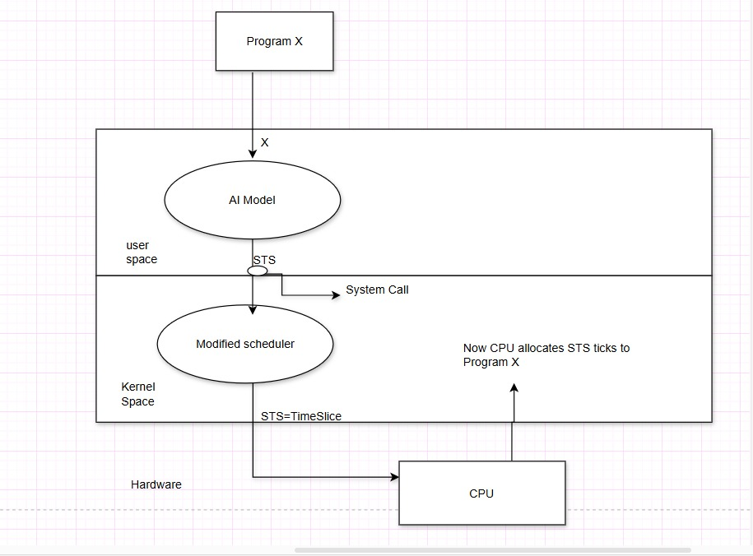
Architecture
High-Level System Design
This architecture follows a Microkernel-based AI-Assisted Scheduling approach. The AI Model in user space analyzes the workload of Program X and predicts an optimal Smart Time Slice (STS). It then makes a system call to the Modified Scheduler in kernel space, which dynamically adjusts CPU allocation based on AI recommendations. The scheduler enforces the AI-determined time slice and assigns CPU cycles accordingly. This approach improves resource efficiency by integrating machine learning-based adaptive scheduling while keeping the kernel minimal and modular.

Slide 18
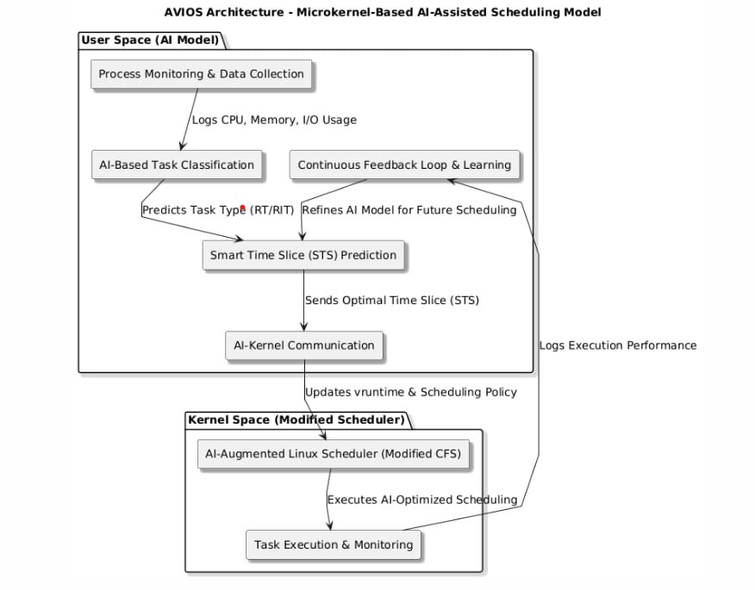
Architecture

Slide 19
Architecture
Application Components :
1. AI-Based Task Classification & Prediction (User Space)
Collects CPU, memory, I/O, context switch data.
Classifies tasks as Real-Time (RT) or Resource Intensive Task (RIT)
Predicts Smart Time Slice (STS) for efficient execution.
2. AI-Kernel Communication Module
System Call (sched_setscheduler()) → Passes AI predictions to the kernel.
Netlink Sockets (Optional) → Ensures efficient data exchange between AI and kernel
3. AI-Augmented Linux Scheduler (Kernel Space)
Receives AI-based scheduling decisions.
Modifies vruntime dynamically in core.c & fair.c.
Allocates CPU time using SCHED_RR (RT) or SCHED_OTHER (BG).
4. Process Execution & Feedback Loop
CPU executes tasks based on AI-modified scheduling.
Feedback loop ensures continuous AI model training for improved accuracy.

Slide 20
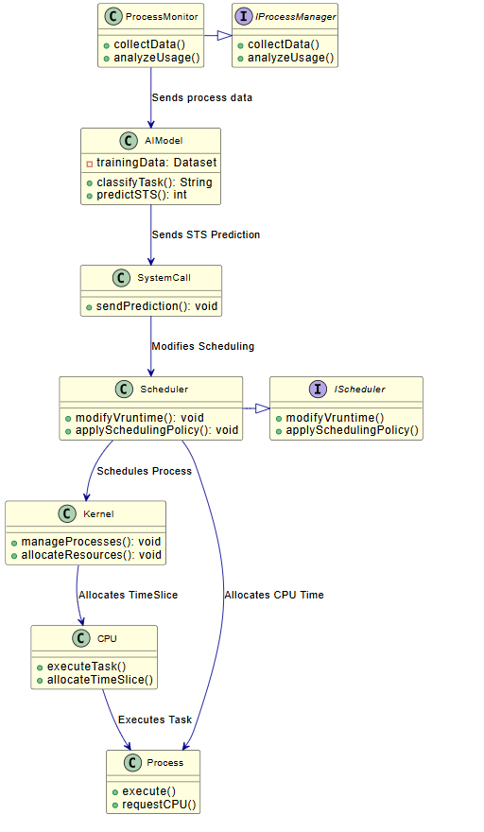
Design Description
Master Class Diagram

Slide 21
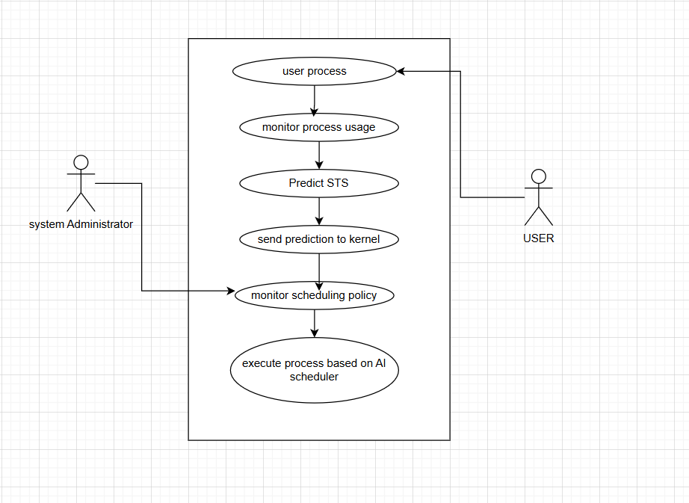
Design Description
Use Case Diagram

Slide 22
Capstone Phase-I timeline
Phase-1: Background Study, Problem Formulation, Literature Survey (Semester 5)
Duration: Months 1-4
Month 1:
Team formation and role allocation.
Identify areas of interest and domain selection.
Conduct initial brainstorming sessions to define a tentative problem statement.
Month 2:
Perform a detailed background study.
Collect data, identify gaps in existing solutions, and refine the problem statement.
Month 3:
Conduct an extensive literature survey (minimum 10-15 papers).
Analyze related work, existing methodologies, and tools.
Month 4:
Finalize the problem statement.
Submit the report containing the background study, refined problem statement, and literature survey.

Slide 23
Capstone Phase-II timeline
Phase-2: High-Level Design, Part of Implementation (Semester 6)
Duration: Months 5-8
Month 5:
Define system requirements and specifications.
Develop high-level architecture (flowcharts, block diagrams, UML diagrams).
Month 6:
Select tools, frameworks, and platforms for implementation.
Start implementing critical modules (proof of concept).
Month 7:
Conduct initial testing of implemented modules.
Review design and implementation progress.
Month 8:
Submit a progress report with high-level design and partial implementation details.

Slide 24
Capstone Phase-III timeline
Phase-3: Low-Level Design, Complete Implementation, Draft Paper (Semester 7)
Duration: Months 9-12
Month 9:
Develop low-level designs (detailed workflows, module-level diagrams).
Begin integrating all system modules.
Month 10:
Complete system implementation.
Perform system-level testing and debugging.
Month 11:
Analyze results and compare them with existing solutions.
Draft a research paper outlining the methodology, implementation, and results.
Month 12:
Submit a comprehensive report with low-level designs, full implementation, and the paper draft.

Slide 25
Capstone Phase-IV timeline
Phase-4: Paper Publication (Semester 8)
Duration: Months 13-16
Month 13:
Finalize the research paper (align with Scopus/Web of Science/UGC guidelines).
Perform a thorough review, incorporating mentor feedback.
Month 14:
Submit the paper to selected journals or conferences.
Begin preparing the final capstone project presentation.
Month 15:
Await feedback from the journal. Address reviewer comments if required.
Fine-tune the project report and presentation.
Month 16:
Publish the paper upon acceptance.
Deliver the final project presentation and submit the complete documentation.

Slide 26
Conclusion
Summing Up:
The AVIOS project integrates AI into the Linux kernel to enhance task scheduling and system performance, making operating systems smarter and more adaptive to dynamic workloads.
Project Highlights:
AI-driven task scheduling optimizes CPU usage and reduces context switching overhead.
Built on the Linux kernel, leveraging TensorFlow, PyTorch, and other modern technologies for seamless integration.
Future Prospects:
Potential to create a custom AI-optimized kernel for even more efficient task allocation.
Expansion into real-time threat mitigation and adaptive resource scaling for better system performance.
Team Commitment:
The team is focused on overcoming challenges in scalability, computational overhead, and real-time integration to deliver a robust and efficient system.
Final Note:
AVIOS marks a significant step toward next-generation operating systems, prioritizing smarter security and dynamic resource management.

Slide 27
References
Hongjiu Lu, ELF: From the Programmer’s Perspective, Technical Report, NYNEX Science and Technology, 500 Westchester Avenue, White Plains, NY 10604, USA, May 1995.
Aivazian, Tigran, Linux Kernel 2.4 Internals, The Linux Documentation Project, August 2002.
Maurice Bach, The Design of the Unix Operating System, Pearson Education Asia, pp. 159-170, 2002.
Fredrik Vraalsen, Performance Contracts: Predicting and Monitoring Grid Application Behavior, In Proceedings of the 2nd International Workshop on Grid Computing, November 2001.
Richard Gibbons, A Historical Application Profiler for Use by Parallel Schedulers, Lecture Notes on Computer Science, Volume 1297, pp. 58-75, 1997.
Hyok-Sung Choi and Hee-Chul Yun, Context Switching and IPC Performance Comparison between uClinux and Linux on the ARM9-Based Processor, Linux in Embedded Applications, January 2005. [Online]. .
Warren Smith, Valerie Taylor, and Ian Foster, Predicting Application Run Times Using Historical Information, Job Scheduling Strategies for Parallel Processing, IPPS/SPDP'98 Workshop, March 1998.
Kishore Kumar P. and Atul Negi, Characterizing Process Execution Behaviour Using Machine Learning Techniques, In DpROM Workshop Proceedings, HiPC 2004 International Conference, December 2004.
S.R. Garner, WEKA: The Waikato Environment for Knowledge Analysis, In Proceedings of the New Zealand Computer Science Research Students Conference, pp. 57-64, 1995.
Surkanya Suranauwarat and Hide Taniguchi, The Design, Implementation, and Initial Evaluation of an Advanced Knowledge-Based Process Scheduler, ACM SIGOPS Operating Systems Review, Volume 35, pp. 61-81, October 2001.
Mark A. Hall, Correlation-Based Feature Selection for Machine Learning, Master's Thesis, Department of Computer Science, University of Waikato, pp. 7-9, 12-14, April 1999.
Andrew Marks, A Dynamically Adaptive CPU Scheduler, Master's Thesis, Department of Computer Science, Santa Clara University, pp. 5-9, June 2003.
Robert Love, Linux Kernel Development, 1st ed., Pearson Education, 2004.
Daniel P. Bovet and Marco Cesati, Understanding the Linux Kernel, 2nd ed., O’Reilly & Associates, December 2002.
Tom Mitchell, Machine Learning, 1st ed., McGraw-Hill International Edition, pp. 52-75, 154-183, 230-244, 1997.
O. Duda and P.E. Hart, Pattern Classification, Wiley, New York, 1973.

Slide 28
Thank You

